Slide 1
INVESTMENT CASE STUDY SUBMISSION
Group Name:
Shiksha
Apurva Chindarkar
Vinayaka Singh
Puneeth A

Slide 2
Spark Funds Investment Plan
Spark Funds, an Asset Management Company
Investment Plan for the Company:
Invest 5 to 15 million USD
Invest in Countries having maximum investment.
Invest in English-speaking countries.
Investment Strategies:
Identify the Best Sector,
Identify the countries where most investors are investing
Identify the Top English-Speaking Countries among top country to invest.
Identify the suitable investment Type to invest.

Slide 3
Problem solving methodology
Import data from ‘Companies’ and ‘round2’ and create two Data frames
Get Unique companies in both the Data frames
Check if ‘round2’ contains all companies listed in ‘companies’ Data frame
Perform an Inner Join to merge ‘round2’ and ‘companies’ to create master_Dataframe
Perform data cleaning on master_Dataframe
Perform the Data Cleanup by replacing nan by np.NAN and dropping them from : ‘country_code’
Convert field: ‘raised_amount_usd’ to $millions
Group master_dataframe on field:’funding_type’ and sort the frame on field: ‘raised_amount_usd’
Get ‘funding_type’ for ‘raised_amount_usd’ between 5 to 15$M. i.e: ‘VENTURE’
Filter the master_dataframe for ‘VENTURE’
Group on field: ‘country_code‘ , get sum of field:’raised_amount_usd’
Get the Top 9 countries by sorting the result in descending order.
Extract ‘Primary Sector’ from Category_list
Import ‘mapping.csv’ as ‘mapping’ dataframe and map ‘main sector’ to’category_list’
Perform Inner join on ‘mapping’ and extracted ‘Primary Sector’ from Category_list
Create data frame for country: USA and funding 5-15$M
Repeat last three steps twice for country : GBR and IND
Find total amount of investment, get count of investment and Get top3 sector based on count.
Get top companies in ‘sector 1’ and ‘sector2’

Slide 4
Global Analysis
Number of unique companies available for analyzing the investment plan for Spark Funds : 66368
The Funding Types which has highest funding Average amount: post_ipo_debt
The Funding type which is not less popular with lowest funding Average amount: non_equity_assistance
Spark Funds best suited Funding Type with Average amount ranges between: 5-15$M: Venture
The top 9 Countries where most investments are occurring: USA, CHINA, IND,GBR,CAN,FRA,ISR,DEU,JPN
Spark Funds best suited Funding countries with English speaking: USA, IND,GBR

Slide 5
Analysis for Country: USA
Total number of Investments (count) : 12012 $M
Total amount of investment (USD) : 107318.2947 $M
Top Sector name (no. of investment-wise) : Others
Second Sector name (no. of investment-wise) : Social, Finance, Analytics, Advertising
Third Sector name (no. of investment-wise) : Cleantech/Semiconductors
Number of investments in top sector (3) : 2950
Number of investments in second sector (4) : 2714
Number of investments in third sector (5) : 2300
For point 3 (top sector count-wise), which company received the highest investment: Virtustream
For point 4 (second best sector count-wise), which company received the highest investment: SST Inc. (Formerly ShotSpotter)

Slide 6
Analysis for Country: GBR
Total number of Investments : 619 $M
Total amount of investment (USD) : 5365.2283 $M
Top Sector name (no. of investment-wise) : Others
Second Sector name (no. of investment-wise) : Social, Finance, Analytics, Advertising
Third Sector name (no. of investment-wise) : Cleantech/Semiconductors
Number of investments in top sector (3) : 147
Number of investments in second sector (4) : 133
Number of investments in third sector (5) : 128
For point 3 (top sector count-wise), which company received the highest investment: Electric Cloud
For point 4 (second best sector count-wise), which company received the highest investment: Celltick Technologies

Slide 7
Analysis for Country: IND
Total number of Investments (count) : 328 $M
Total amount of investment (USD) : 2949.543 M $M
Top Sector name (no. of investment-wise) : Others
Second Sector name (no. of investment-wise) : Social, Finance, Analytics, Advertising
Third Sector name (no. of investment-wise) : Cleantech/Semiconductors
Number of investments in top sector (3) : 110
Number of investments in second sector (4) : 60
Number of investments in third sector (5) : 52
For point 3 (top sector count-wise), which company received the highest investment : FirstCry.com
For point 4 (second best sector count-wise), which company received the highest investment: Manthan Systems

Slide 8
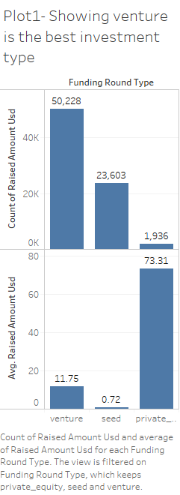

Slide 9
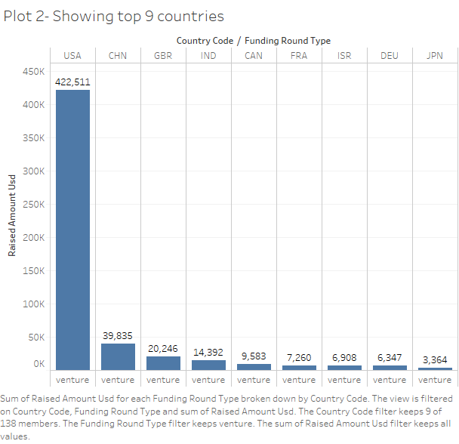

Slide 10
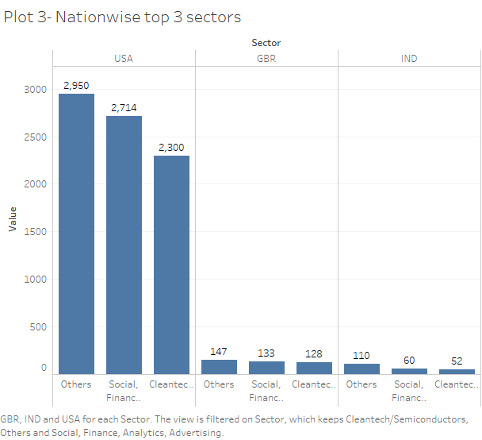

Slide 11
Conclusions
Based on Data Analysis following Investment Plan to recommend for Spark Funds:
Country to invest: USA
Best suited Investment Type: Virtustream
Top 3 Sectors for Investment:
Others
Social, Finance, Analytics, Advertising
Cleantech/Semiconductors
The recommended company to invest based on the company received highest investment: SST Inc. (Formerly ShotSpotter)

